Slide 1
Curriculum Night 2013 A look in to our 3rd grade year!
To get ready:
Find your child’s seat (this is your spot!)
3. We will do conference and volunteer sign-up afterward

Slide 2
Feel free to ask questions at any time!
*Website and Blog Update!!

Slide 3
Important Links
There are various hyperlinks throughout this presentation to supplement content and for your reference.
Here are two very important links to bookmark:
www.qaeliner2014.weebly.com - Classroom Website
http://www.queenanneelementary.com/student--parent-handbook.html - Student-Parent Handbook

Slide 4
Philosophy and Goals Social/Emotional and academic learning are mutually inclusive. As a team, we will work to educate The Whole Child.
Social & Emotional Learning The foundation of our classroom is built with relationships -Positive Discipline program through Classroom Meetings *
To learn more about Positive Discipline, visit: http://www.positivediscipline.com/what-is-positive-discipline.html Academic Learning The work we will do this year will be dynamic, engaging, and focused. Students will access learning through a variety of instructional approaches. We will be incorporating Project Based-Learning (PBL) and technology with our existing grade-level standards and curriculum.
We Work on Learning Continuums
Students self assess, set goals, monitor work to constantly be growing
Teachers teach whole group concepts, confer individually with each student, hold small group target instruction based on data

Slide 5
Executive Functioning

Slide 6
Common Core Standards &
http://www.corestandards.org/

Slide 7
Shift in Mathematics
Focus: to narrow and deepen strong foundational knowledge and deep conceptual understanding
-Students will gain mastery in previous grade level standards, 3rd grade standards, and opportunity to challenge thinking and stretch higher-order thinking skills
A variety of instructional models will be used to facilitate learning
ST Math (available at home, as well)

Slide 8
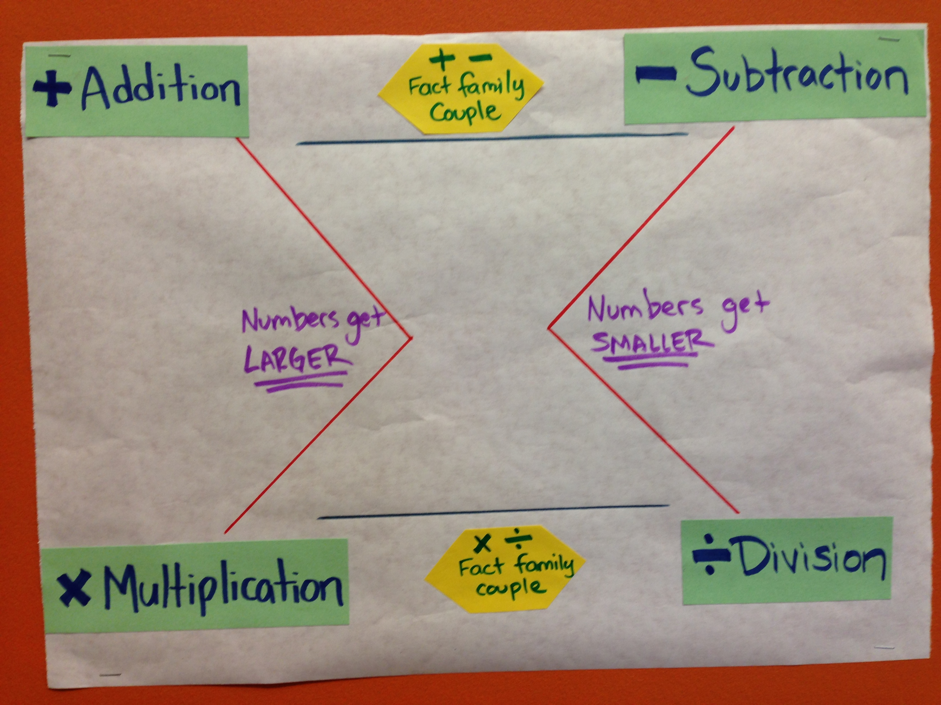
Beginning of Year Math Goals
Third Grade MATH Goals
Strengthen number sense through Math Talks- a series of mental math strategies that task students to solve problems in multiple ways and stretch to understand the methods used by others.
Memorize multiplication facts! Build fluency with addition and subtraction facts. (games, apps, online tools, flashcards, YouTube songs, in the car!)
Learning to manipulate within the four operations (addition, subtraction, multiplication, division)
Learning when to use each operation and multiple strategies to successfully use each operation
Performance Tasks

Slide 9
Beginning of year LITERACY goals
*Developmental Jump: Making independent inferences
Building a Reading Life: Students are learning that reading is a balance of fluency and comprehension, what their current strengths are, and how they can strengthen themselves as readers. I will be sending home information about your child’s reading level and how you can support them at home.
Avid, Addictive Reading! We want our kids to be reading a variety of levels, Genres, and having many different reading experiences.
Reading Toolkit: Learning the tools skilled readers use, watching them through modeling, guided practice, and then using independently.
Building writing stamina, developing writing routines and processes and setting goals.

Slide 10
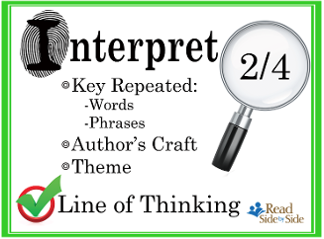
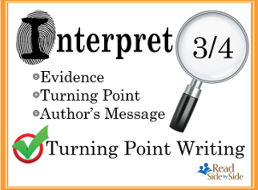
CIA Instruction (Read Side By Side)

Slide 11
PBL: Project Based Learning
We will complete two project types this year :
Inquiry based, cross curricular, engaged and powerful learning, promotes executive functioning
Year-Long Project: Journey North
A global study of wildlife migration and seasonal change.
*Many cross-curricular connections throughout the
year with an all 3rd grade culminating project at the
end of the year!
https://www.learner.org/jnorth/
1-2 Creativity Projects: Genius Hour-like tasks that will be half day-long sessions lasting about a week
Opportunities for frequent volunteering and guest experts!
Much more information to come ☺

Slide 12
Home Support Balanced View Article:http://www.sharingsuccess.org/code/bv/homework.pdf
Students are expected to read every day!
Share your reading life and stay tightly connected with your reader.
*Students bring home their Writer’s Notebooks and Book Bags each night. Read thorough their Notebooks. If something happens at home that could inspire an entry-write down the “seed” idea!
*Portfolios are available for checkout at anytime but stay at school regularly.
*We know that each family has a different schedule and different view on homework. We have a variety of homework options that you can program in to your life as you see best fit!
-Online Learning Programs
http://www.qaelibrary.org/resources.html
*Focus on ST Math, Journey North Reporting, Weebly Blogging, Math fact fluency, or Typing
Notes:
Show a reading log sample

Slide 13
Dwankhozi Hope Partnership
http://dwankhozi-qae.weebly.com/
There is a lot we can learn from our new friends, and much we can share with them, as well!
Student-led ideas
Writing pen pal letters
Sharing art and student writing
Photos
Incorporating with PBL and connecting across content areas

Slide 14
Time Capsule letter ☺
Please take moment to write a letter to your child that they will open and read at the very end of the year.
Ideas:
- What you hope for them to accomplish this year
- What their strengths are at this time
- Compliments and what makes you so proud
Don’t forget to sign up for a conference time, look through your child’s portfolio, indicate desired times on the volunteer schedule, and tour our room to see what else we are up to!

